Slide 1




Odder
Squatters

Slide 2

Kaggle Competition

Slide 3
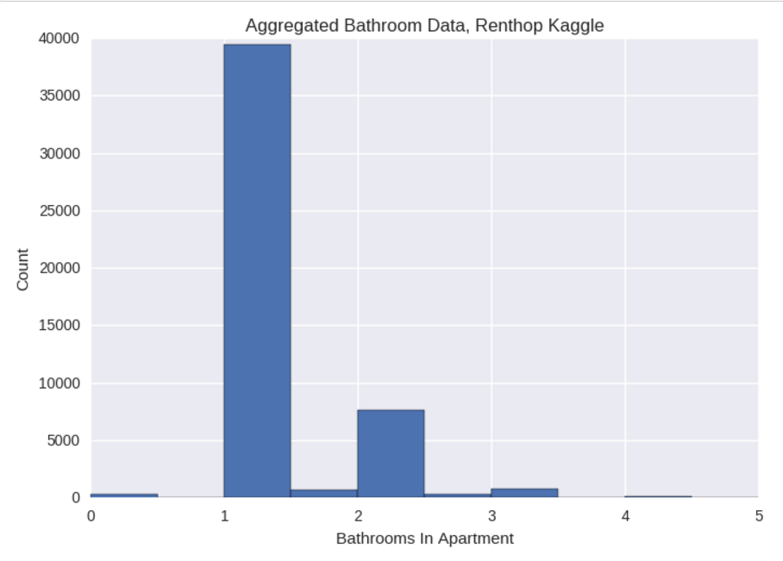
What’s In The Data?

Slide 4

Normal Data is Elusive

Slide 5
Building
Models

Slide 6

Random Forest: Easy To Implement

Slide 7


Is Manager Skill Predictive of Interest Level?

Slide 8
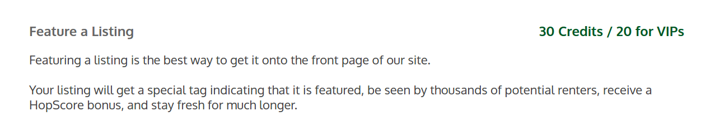
Paying Money to Renthop is Predictive of Interest Level
“Each listing on our site comes with their own unique HopScore ranging from 0 – 100. Listings with higher scores are better and appear at the top of search results where they’ll receive more exposure from renters.”

Slide 9

Investigate The Source

Slide 10

Regressions and KNN : Peng
{ 'C': 0.01438449888287663,
'class_weight': None,
'dual': False,
'fit_intercept': True,
'intercept_scaling': 1,
'max_iter': 100,
'multi_class': 'ovr',
'n_jobs': 3,
'penalty': 'l1',
'random_state': None,
'solver': 'liblinear',
'tol': 0.0001,
'verbose': 0,
'warm_start': False }
Grid Search

Slide 11

XGBoost: Amit
param['objective'] = 'multi:softprob' param['eta'] = 0.1 param['max_depth'] = 6 param['silent'] = 1 param['num_class'] = 3 param['eval_metric'] = "mlogloss" param['min_child_weight'] = 1 param['subsample'] = 0.7 param['colsample_bytree'] = 0.7

Slide 12
Putting It
Together

Slide 13

Ensembling Theory is Scattered, so K.I.S.S.

Slide 14
Results Turned Out Well!
logloss = .55058

Slide 15
Thank
You
Odder
Squatters
Odder
Squatters
Odder Squatters

